Slide 1
Next Hike Project -04
Project By - Chandra Sekhar Mahanta

Slide 2
Introduction
Objective :
This Project is main Aim objective data process Visualize, and Feature Extraction
Model Building:
Model Evaluation
Feature Importance Analysis

Slide 3
Work flow
Step By Step guide
✔ Step 01: Loaded and Inspected The Dataset. ✔ Step 02: Cleaned Missing Values. ✔ Step 03: Univariate Analysis Showed. ✔ Step 04: Extraction. ✔ Step 05: Model Building. ✔ Step 06: Model Evaluation. ✔ Step 07: Feature Importance Analysis

Slide 4
Data Sheet Preprocessing: Refining the Data
Data Loading
Feature Engineering
Normalization/Scaling
Explore using .head(), .tail(), .describe(), .duplicates(), handling missing data, date manipulation, outlier detection, and dropping irrelevant columns
Extract relevant features from the data
Transform features to a common scale

Slide 5
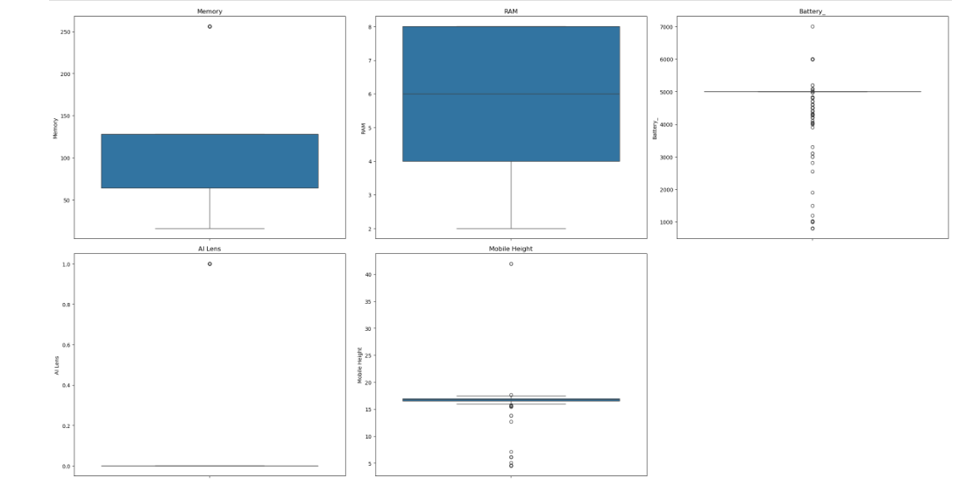
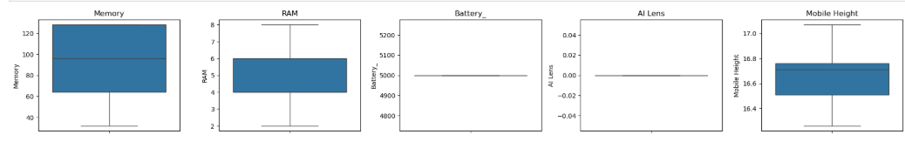
PERFERMING THE EDA ON DATA SHEET
Before Handling Outliers
After Handling Outliers
After handle Checking outlier with visualize with using box plot all numeric columns
Checking outlier with visualize with using box plot all numeric columns

Slide 6
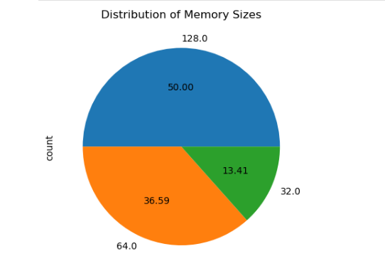
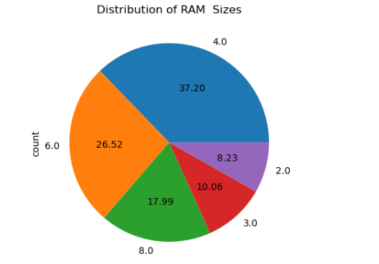
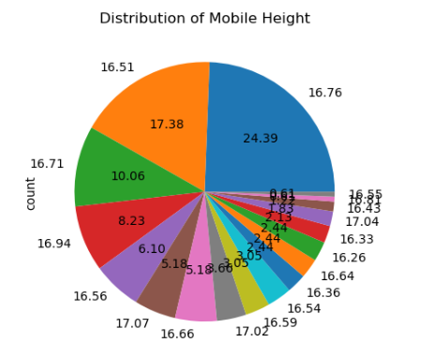
Univariate Analysis
1-The chart is divided into multiple segments, each representing a specific mobile height.
2- The largest segment corresponds to the value 16.76, with a percentage of 24.39%.
3- Other significant segments include 17.38, 16.51, 16.71, and 10.06%.
4- The chart appears cluttered due to a high number of unique values, making the labels difficult to read.
1- 128GB Storage is the most common, accounting for 47.83% .
2- 64GB Storage follows with 31.07%. 256GB Storage represents 10.36% of the data.
3-32GB Storage has a smaller presence (9.79%).
4-16GB Storage is the least common, with only 0.94%.
1-RAM Size 4GB has the highest percentage (33.90%).
2- 8GB RAM is the second most common (29.19%).# 6GB RAM accounts for 22.41% .
3- 2GB (6.97%) and 3GB (7.53%) are the least common.

Slide 7
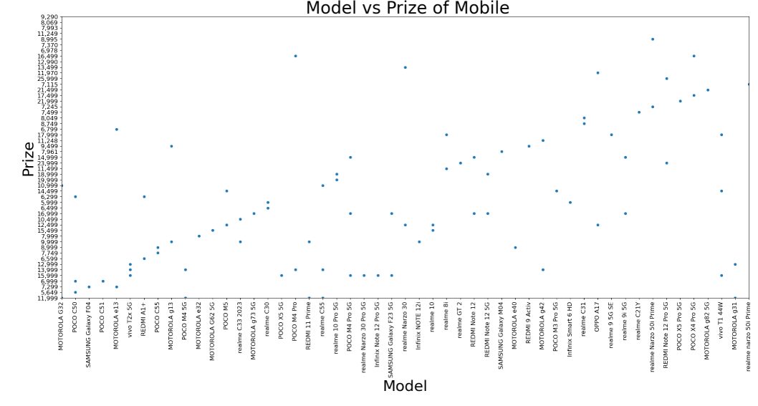
Model VS Prize
1- This scatter plot provides a clear and insightful visualization of the relationship between different mobile models and their respective prices.
2- The distribution of points shows that higher-priced models tend to be more spread out, while lower-priced models are clustered together.
3- This suggests that budget models have a consistent pricing range, whereas premium models vary significantly in price.
4- Since "Model" is a categorical variable, the x-axis labels are rotated for better readability, allowing us to distinguish each mobile brand clearly.# Some brands show a wide range of pricing, indicating multiple variants (basic, mid-range, and premium models).#Certain data points are positioned significantly higher than others, indicating premium flagship models.

Slide 8
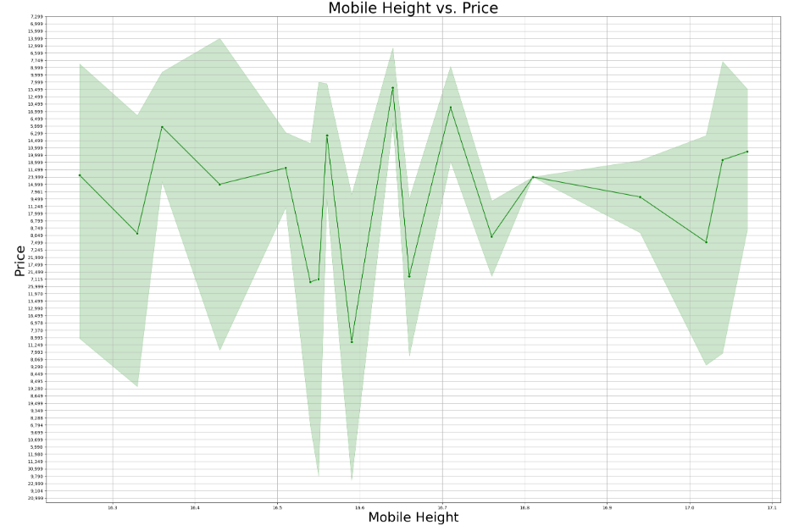
Mobile Height VS Price
1- The X-axis represents Mobile Height, likely measured in inches or centimeters.
2- The Y-axis represents Price, indicating the cost of mobile devices.
3- The green line represents the trend of price variation with mobile height.
4- The shaded region represents the confidence interval or variability in pricing at each height.
5- High Variability: The plot exhibits significant fluctuations, suggesting that mobile price does not follow a simple linear trend with height.
6- Extreme Deviations: Certain height ranges (e.g., around 16.5 - 16.7) show drastic spikes and dips, indicating outliers or inconsistent pricing.
7- Unreliable Pattern: The lack of a clear trend suggests that mobile height alone may not be a strong predictor of price.

Slide 9
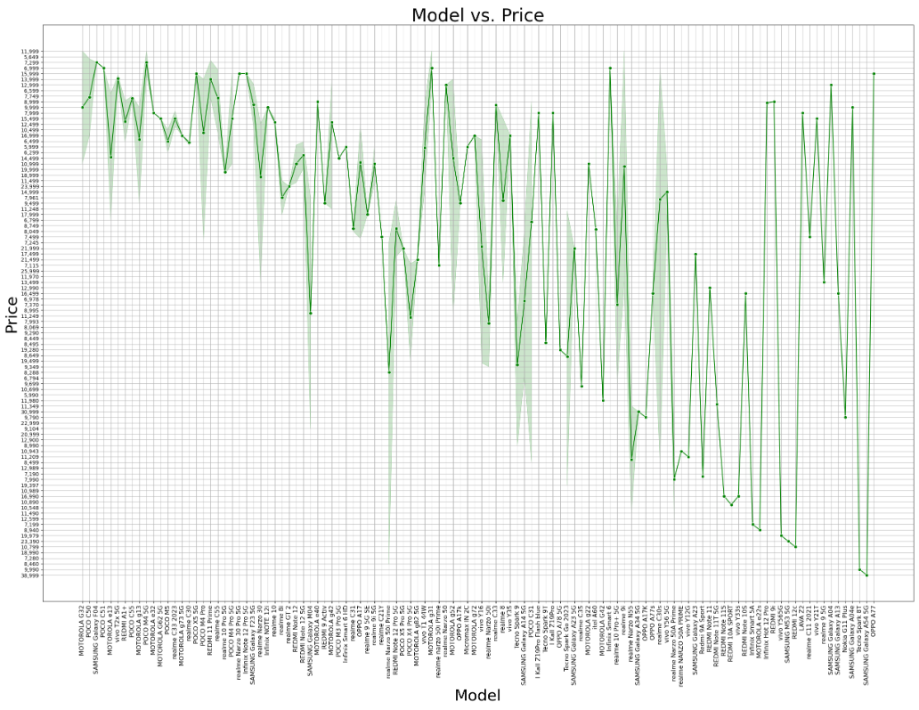
Mode VS Price
1- X-axis: Represents different mobile models, with labels rotated for readability.
2- Y-axis: Represents price, showing the cost distribution across models.
3- Green line: Represents price trends for different models. Shaded region: Indicates the variability or confidence interval in pricing for each model.
4- High Price Fluctuation: Prices vary significantly across different models, with no clear linear trend.
5- Sudden Price Drops: Certain models have extreme low-price points, indicating budget devices or discounts.
6- Clusters of Expensive Models: Some brands/models have consistently high pricing, likely premium or flagship devices.
7- Dense and Unreadable Labels: The number of models makes it hard to interpret specific values without filtering.

Slide 10
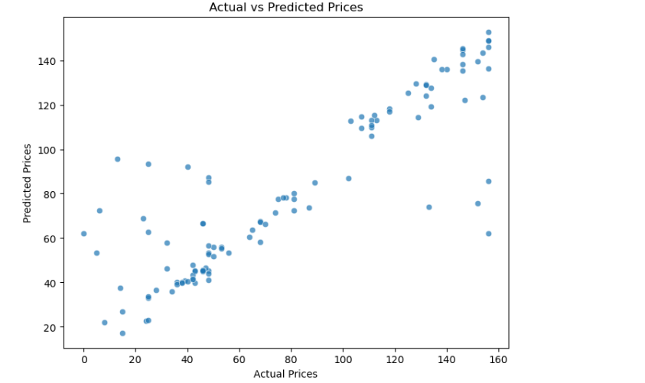
MODEL BUILDING
1- The clustering along an upward diagonal indicates the model captures the overall price pattern well.
2- Some points deviate significantly from the trend, suggesting occasional mispredictions.
3- Wider spread at higher price ranges could indicate inconsistencies in feature importance
4- A tight clustering along an ideal 45-degree line would indicate near-perfect predictions.
5- The scatter spread suggests further optimization is needed—possible improvements include feature selection,
6-hyperparameter tuning, or using a more complex model.

Slide 11
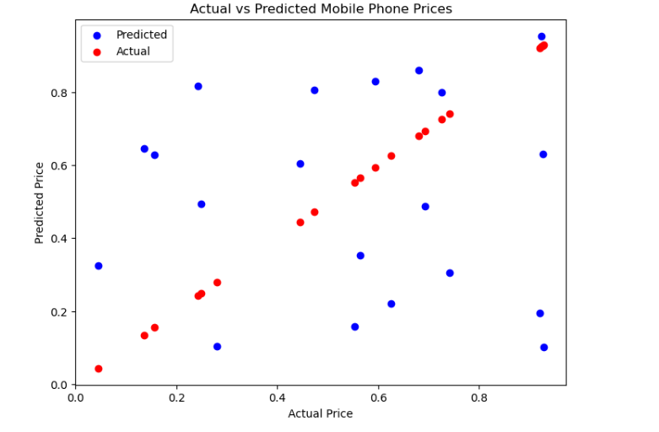
MODEL EVALUTAION
1-The red dots (actual prices) follow a near-diagonal pattern, indicating the true distribution.
2- The blue dots (predicted prices) deviate from this ideal line, showing where the model makes errors.
3- If predictions were perfect, all blue points would align with red points.
4- he scattered blue points suggest inconsistencies, particularly in underestimating or overestimating certain values.
5- A tight clustering along the diagonal would indicate high accuracy.
6- The spread suggests the model may not have fully captured underlying pricing patterns.

Slide 12
Preprocessing and Feature Engineering : A Recap
1
Processed Data
2
Visualization
Ready for comprehensive analysis
Revealed insights about seasonality, hourly trends, and overall demand
3
Key Values
Understanding user behavior and optimizing for efficiency

Slide 13
THANK YOU

